Slide 1
POWER FLOW ANALYSIS
Chapter 1

Slide 2
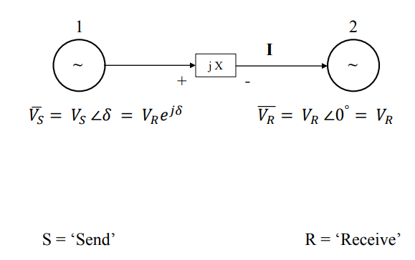
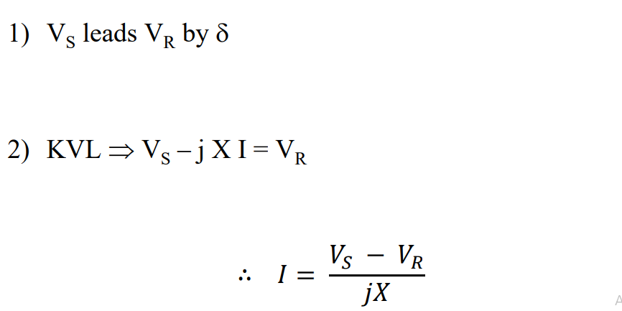
Power flow in Transmission line

Slide 3
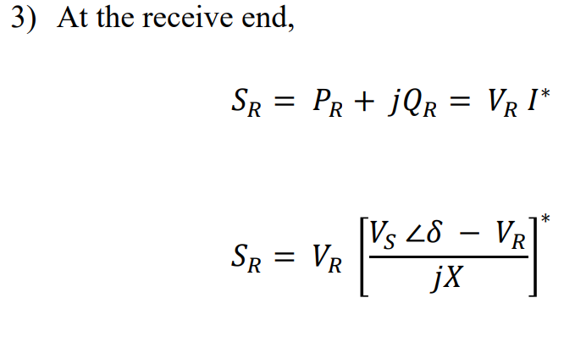
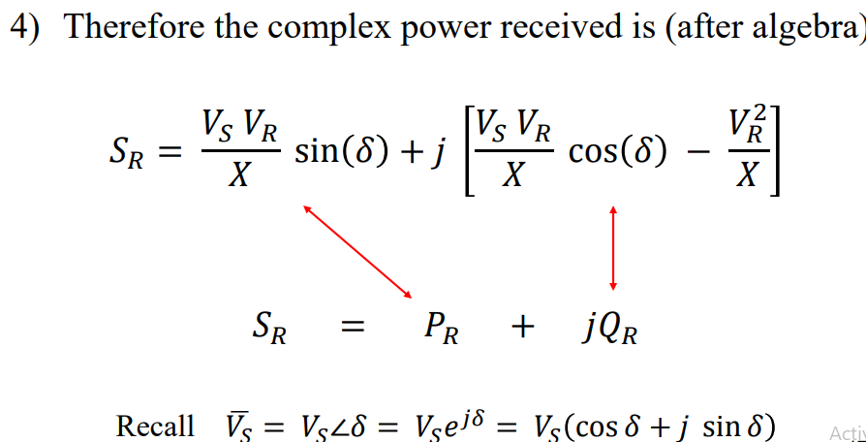

Slide 4
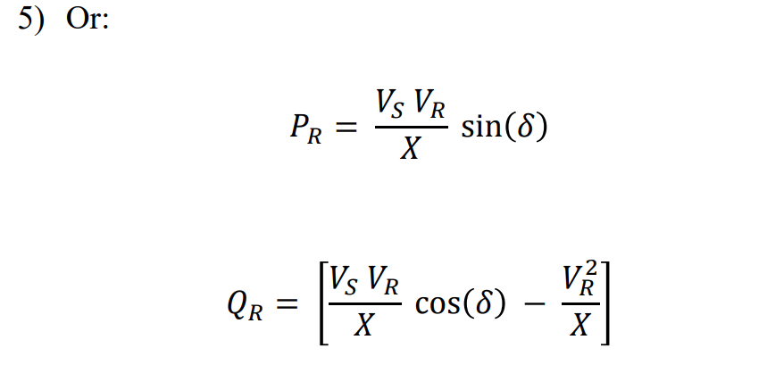
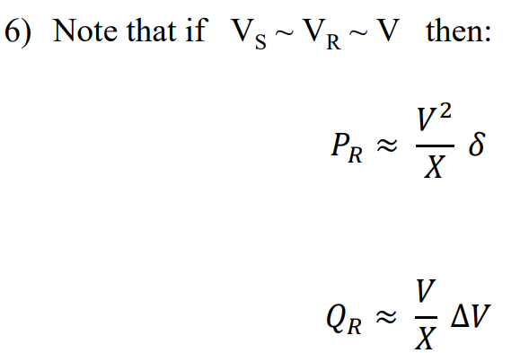

Slide 5
Power flow studies/load flow studies
It gives a mathematical approach for determining various bus voltage, their phase angle, active and reactive power flow through different branches, generator and loads under steady state conditions.
In power system, active power(P) and reactive power(Q) is supplied or drawn from the load buses. The study of flow of these power are called load flow or power flow.
Thus in power flow studies four electrical quantities are used on each bus.
i) Net Active power injected at any bus – P
ii) Net reactive power injected at any bus – Q
iii) Voltage magnitude at any bus – V
iv) Phase angle of voltage at anu bus - δ

Slide 6
Importance of power flow studies
Helps in study the short circuit condition for any interconnected system.
Helps in continuous monitoring of current power system state.
Helps in making future plans like expansion and improvement of power system, determination of load Centre, selecting location for power capacitor for power factor improvement and raising the network voltage.
Helps us in determining the best location as well as optimal capacity of proposed generating stations, substation and new lines.

Slide 7
Classification of Buses
Two variables at each node are assumed known, while the other two variables are treated as state variables to be resolved or need to be calculated.
According to the original data, the nodes in power systems can be classified into three types:
1) Slack bus/reference bus: In load flow studies, there should be one and only one slack node specified in the power system, which is specified by a voltage, constant in magnitude and phase angle. Therefore, V and δ are given as known variables at the slack node (for instance, 10˚ pu), while the active power P and reactive power Q are the variables to be solved.

Slide 8
2) PV Buses: A PV bus, also called a voltage - controlled bus, is a bus where the voltage magnitude is given and kept constant and the active power injection is specified while the voltage angle and the reactive power injection need to be determined by load flow analysis.
A generator bus may be considered as a PV bus if the voltage of the bus and the active power output from the generator are controlled to the specified values. Sometimes a bus, which a reactive control resource like a synchronous condenser is connected with, may also be taken as a PV bus.

Slide 9
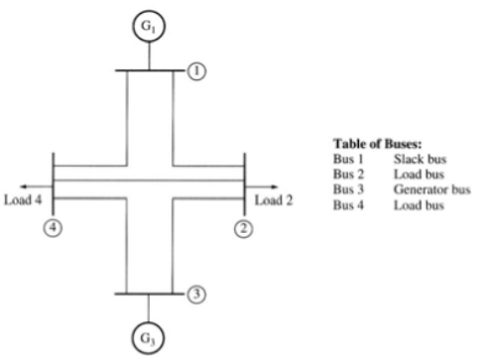
3) PQ Buses/load Buses: For PQ buses, the active and reactive power are specified as known parameters, and voltage & its power angle is to be resolved. Usually, substation nodes are taken as PQ nodes where the load powers are given constants. When output P and Q are fixed in some power plants, these nodes can also be taken as PQ node. Most nodes in power systems belong to the PQ type in load flow calculation.

Slide 10
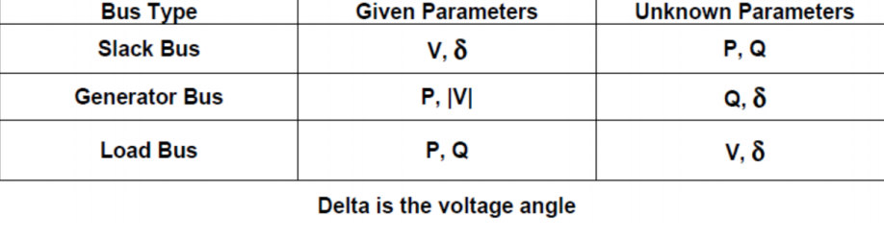

Slide 11
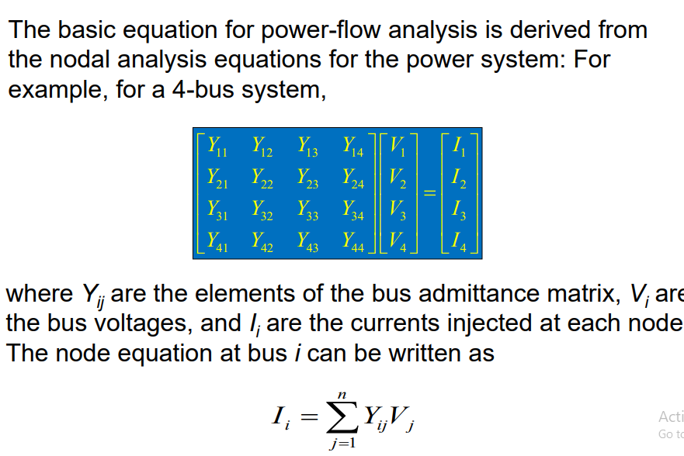
Power-flow analysis equations

Slide 12
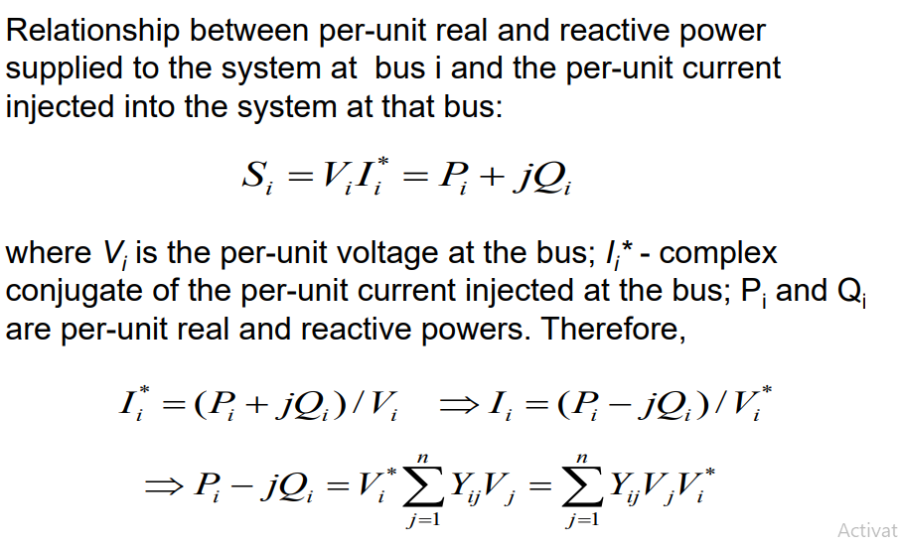

Slide 13
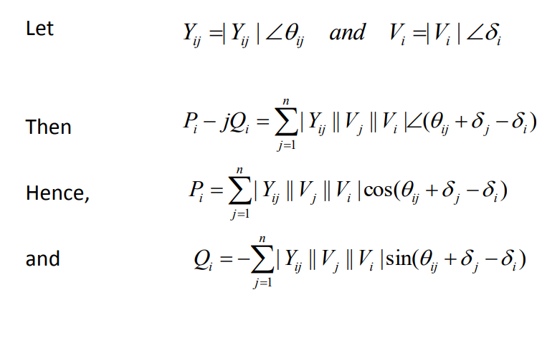

Slide 14
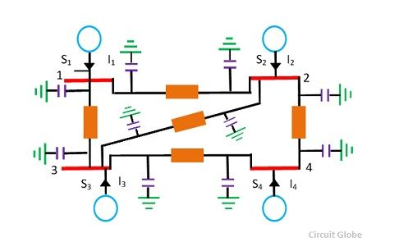
Bus admittance matrix

Slide 15
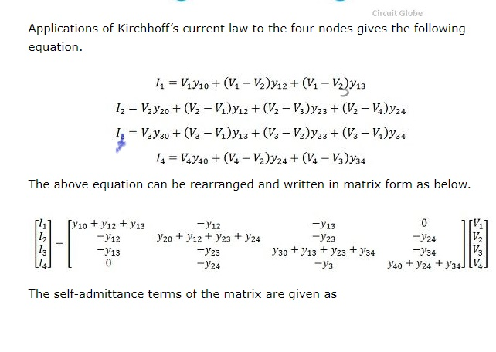

Slide 16
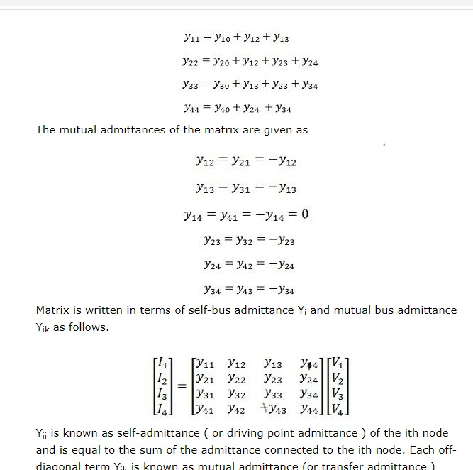

Slide 17
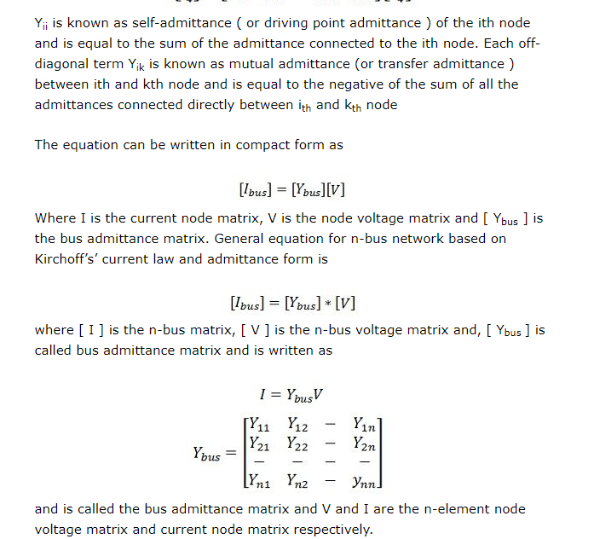

Slide 18
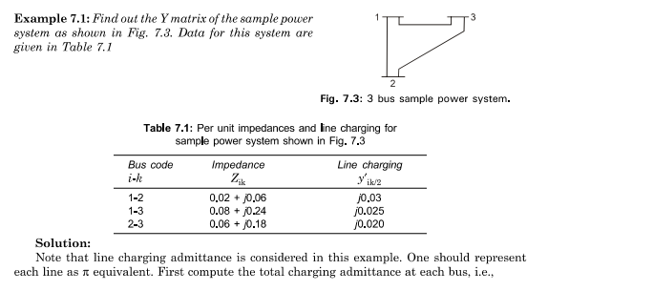

Slide 19
